Slide 1
Manufacturing Data Analysis
Using SQL
Presented By – Nagendra V Kini

Slide 2
Agenda
Introduction
Key Performance Indicators
Query/Output
Conclusion
Final tips & takeaways

Slide 3

Manufacturing Data Analysis
Overview of SQL queries used to analyze manufacturing data.
Focus on key metrics: Manufactured Quantity, Rejected Quantity, Processed Quantity, Wastage, and trends over time.

Slide 4

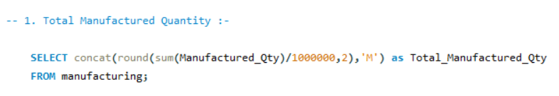
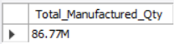
Total Manufactured Quantity
Query: SUM(Manufactured_Qty) / 1,000,000
Result: Displayed in millions (86.77M).
Purpose: To measure the overall production output.

Slide 5
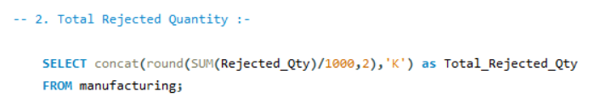
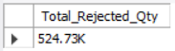
Total Rejected Quantity
Query: SUM(Rejected_Qty) / 1,000
Result: Displayed in thousands (524.73K).
Purpose: To understand the volume of production that did not meet quality standards.

Slide 6
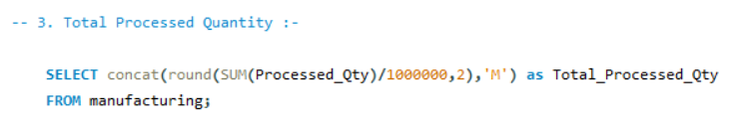
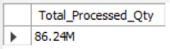
Total Processed Quantity
Query: SUM(Processed_Qty) / 1,000,000
Result: Displayed in millions (86.24M).
Purpose: To track how much of the manufactured quantity has been successfully processed.

Slide 7

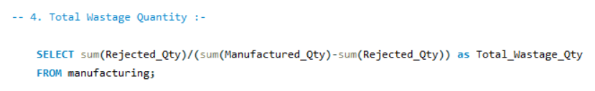
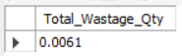
Total Wastage Quantity
Query: SUM(Rejected_Qty) / (SUM(Manufactured_Qty) - SUM(Rejected_Qty))
Result: Ratio of wastage to the effective production.
Purpose: To assess the efficiency of the manufacturing process.

Slide 8
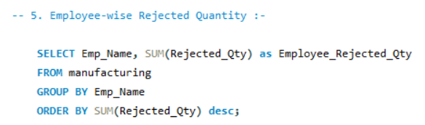
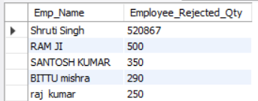
Employee-wise Rejected Quantity
Query: Group by Emp_Name, ordered by SUM(Rejected_Qty).
Result: Displays the total rejected quantity per employee.
Purpose: To identify employees contributing to higher rejection rates.

Slide 9
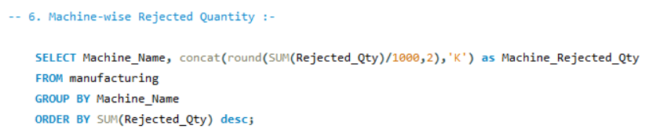
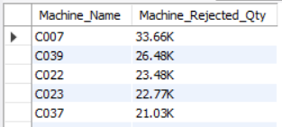
Machine-wise Rejected Quantity
Query: Group by Machine_Name, rejected quantity in thousands.
Result: Displayed in thousands (33.66K).
Purpose: To determine which machines are leading to higher rejection rates.

Slide 10
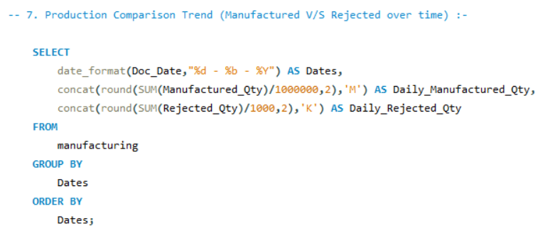
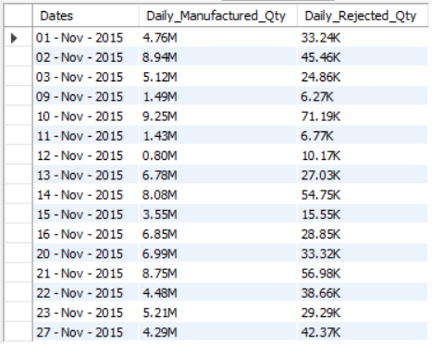
Manufactured V/S Rejected Over Time
Query: Daily trend of Manufactured_Qty and Rejected_Qty.
Result: Time-series comparison in millions and thousands.
Purpose: To observe production efficiency over time.

Slide 11
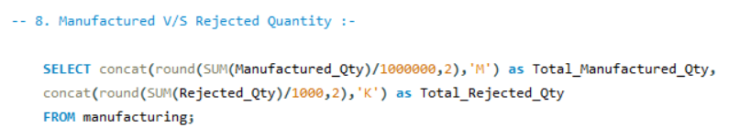
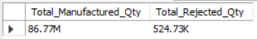
Manufactured V/S Rejected Quantity
Query: Total Manufactured_Qty vs. Rejected_Qty.
Result: Displayed as a comparison between total production and rejection.
Purpose: To provide a high-level overview of production success.

Slide 12
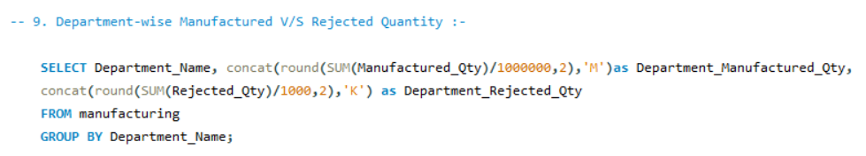
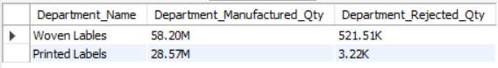
Department-wise Manufactured V/S Rejected Quantity
Query: Group by Department_Name, display in millions and thousands.
Result: Production and rejection data by department.
Purpose: To assess department performance in manufacturing.

Slide 13
Conclusion
Total Manufactured Quantity :- 86.77 million units produced, showcasing the overall scale of the manufacturing operation.
Total Rejected Quantity :- 524.73k units rejected, highlighting the need for quality control improvements.
Total Processed Quantity :- 86.24 million units successfully processed, indicating effective production but with room for efficiency gains.
Total Wastage :- 0.0061% wastage rate, demonstrating a relatively efficient process but with potential areas for waste reduction.
Employee-wise Insights :- Shruti Singh, followed by Ram Ji, Santosh Kumar, Bittu Mishra, and Raj Kumar, had the highest rejected quantities, suggesting targeted training or process review might be beneficial.
Machine-wise Insights :- Machine C007 contributed the most to rejected quantities (33.66k), indicating a potential need for maintenance or recalibration.
Department-wise Analysis :- The One Labels Department had the highest production (58.20 million) and also the highest rejection (521.51k), whereas the Printing Labels Department had a lower production (28.57 million) with a minimal rejection rate (3.22k).

Slide 14
Final tips & takeaways​
Focus on Quality Control :- The significant rejection rates across specific employees and machines suggest the need for enhanced quality control measures, such as regular training and machine maintenance.
Optimize Processes :- With a wastage rate of 0.0061%, there’s a small but impactful opportunity to further streamline the manufacturing process to minimize waste.
Targeted Interventions :- The data highlights specific areas and departments that require focused attention, such as the One Labels Department and Machine C007, to reduce rejection rates and improve overall efficiency.
Continuous Monitoring :- Regular analysis and monitoring of manufacturing trends can help identify and address issues early, leading to more consistent and improved production outcomes.
Leverage Data for Decision Making :- The insights gained from this analysis should be used to inform strategic decisions, ensuring that the manufacturing process is continually optimized for better performance and reduced costs.

Slide 15
THANK YOU
Nagendra V Kini
linkedin.com/in/nagendravkini
https://github.com/nagendravkini

